Slide 1

12/11 Report
By Bolun

Slide 2
Start
One iteration with putting back points（fixed）
Method 2
( Method 1 is Using LP only)
Input Data
Solve LP
Delete Outliers from data
Outliers exist?
Yes
No
# of loops<# of outliers
Yes
No
Put a point back to data
Output Data
Is it an outlier?
Yes
Delete the point from data
End
No

Slide 3
Start
One iteration with Ri（fixed）
Method 3
Input Data
Solve LP
Delete Outliers from data
Outliers exist?
Yes
No
Compute Ri of outliers
# of loops<# of outliers
Yes
No
Put a point back to data
Output Data
Is it an outlier?
Yes
Delete the point from data
End
No

Slide 4
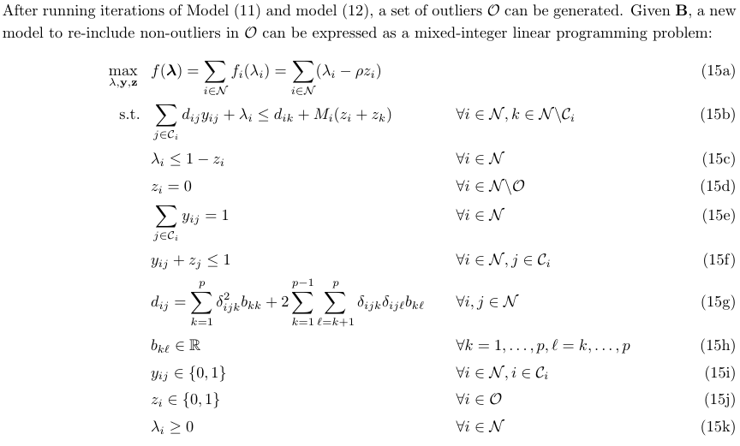
6.3 MILP
To re-add non-outliers into the dataset
<=Yij≠1 if Zj=1
<=Parameter

Slide 5
Start
Whole Process of MILP
Method4
Input Data
Solve LP
Delete Outliers from data
Outliers exist?
Yes
No
Solve MILP
Output Data
End

Slide 6
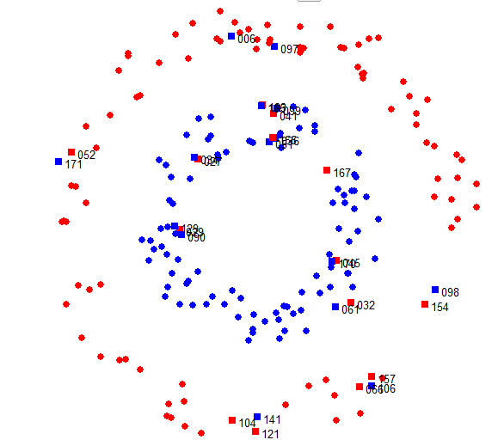
Original Data

Slide 7
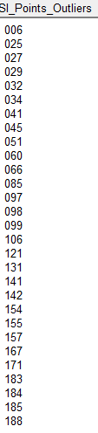
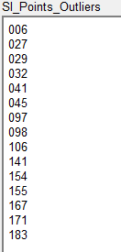
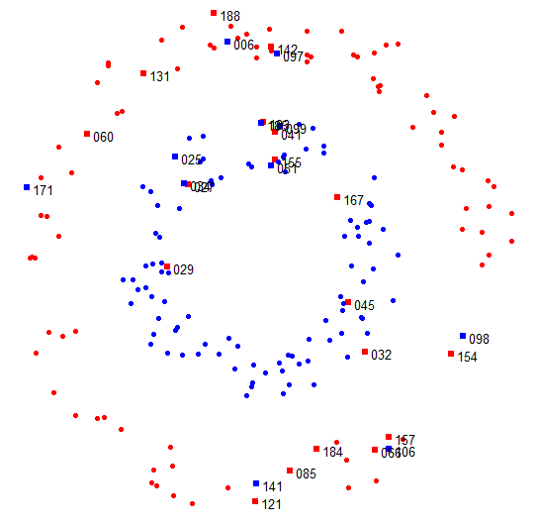
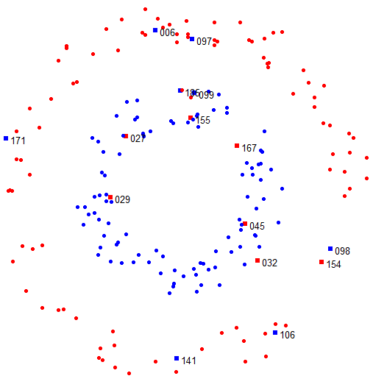
LP Solution
MIP Solution

Slide 8
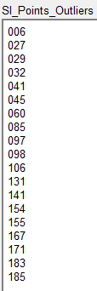
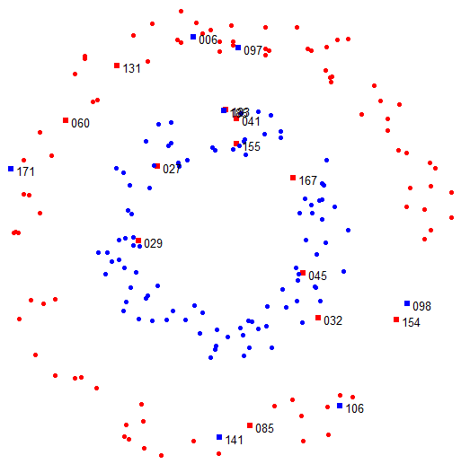
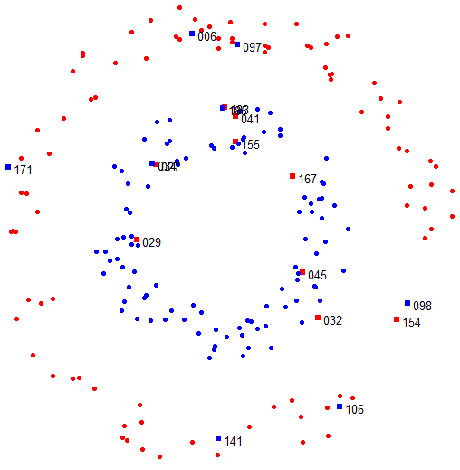
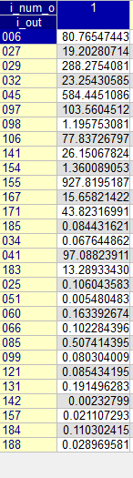
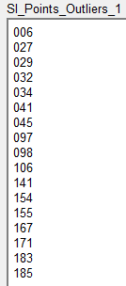
Method 2
1 iteration
Method3
1 iteration
Method 2 and 3 takes more time than method 4 does.

Slide 9
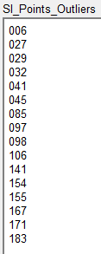
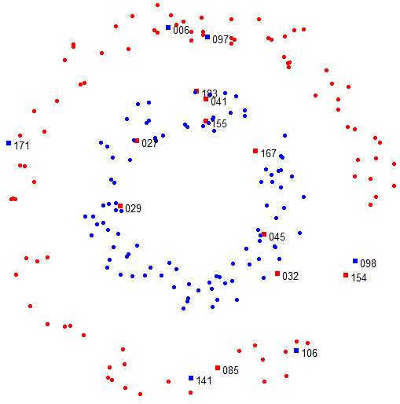
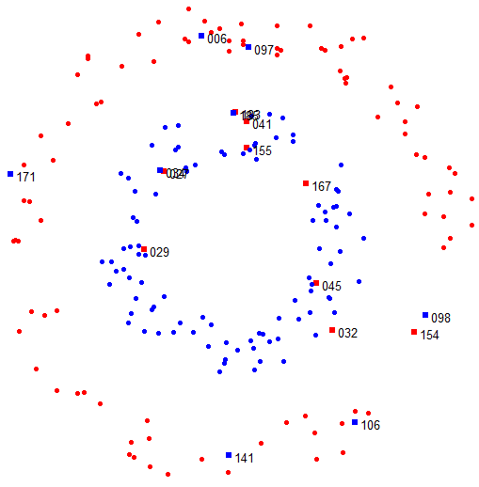
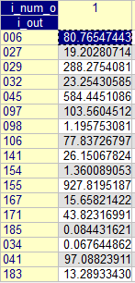
Method 2
2 iterations
Method3
2 iterations

Slide 10
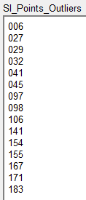
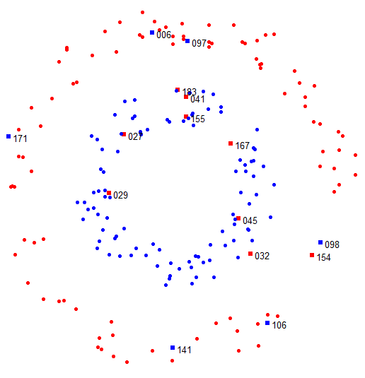
Method 2
3 iterations
Method3
3 iterations

Slide 11
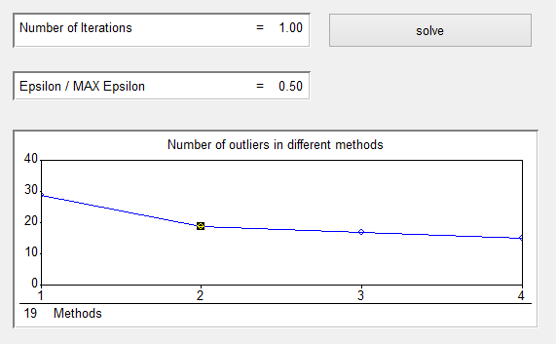

Page in AIMMS to compare # of outliers in different methods
1 Iteration with Epsilon / MAX Epsilon=0.5

Slide 12
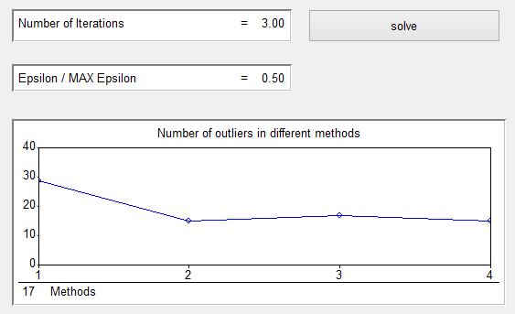

Page in AIMMS to compare # of outliers in different methods
3 Iteration with Epsilon / MAX Epsilon=0.5

Slide 13
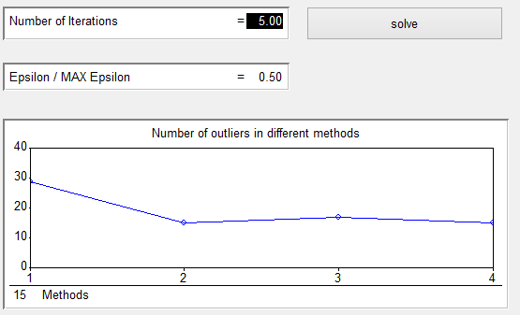
Page in AIMMS to compare # of outliers in different methods
5 Iteration with Epsilon / MAX Epsilon=0.5

Slide 14
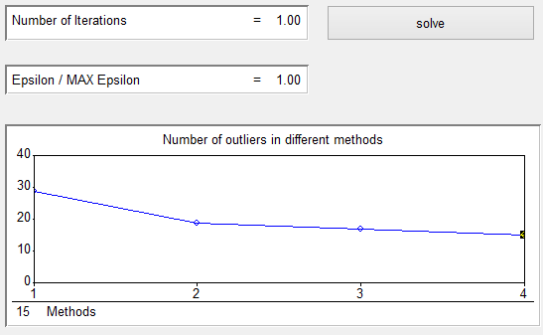
Page in AIMMS to compare # of outliers in different methods
1 Iteration with Epsilon / MAX Epsilon=1

Slide 15
Thank you !

